Slide 1

Version Control System GIT

Slide 2


Oh My God!
I made some changes and my code is not working let me look into previous versions!

Slide 3

myProject-Final
myProject-hereWeGoAgain-Final
myProject V 1.0.0
myProject-ForTheLastDay-Final
myProject V 1.0.1
myProject-Final-Final
myProject-final-final-final
myProject-BeforePresentation-Final
myProject V 1.0.2

Slide 4


Slide 5
Ram
Neil
Divya
GroupProj V 1.0.0
GroupProj V 1.0.0
GroupProj V 1.0.0
GroupProj V 1.0.1
GroupProj V 1.0.1
GroupProj V 1.0.1
GroupProj V 1.0.3
GroupProj V 1.0.3
GroupProj V 1.0.3

Slide 6


Slide 7


Slide 8
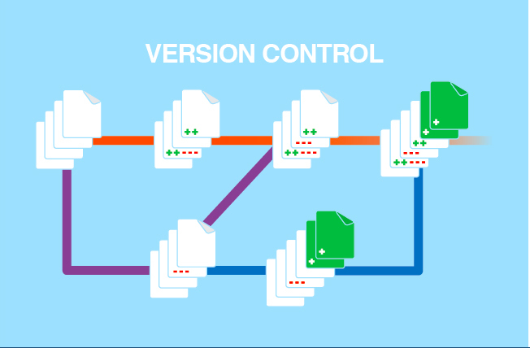

Slide 9
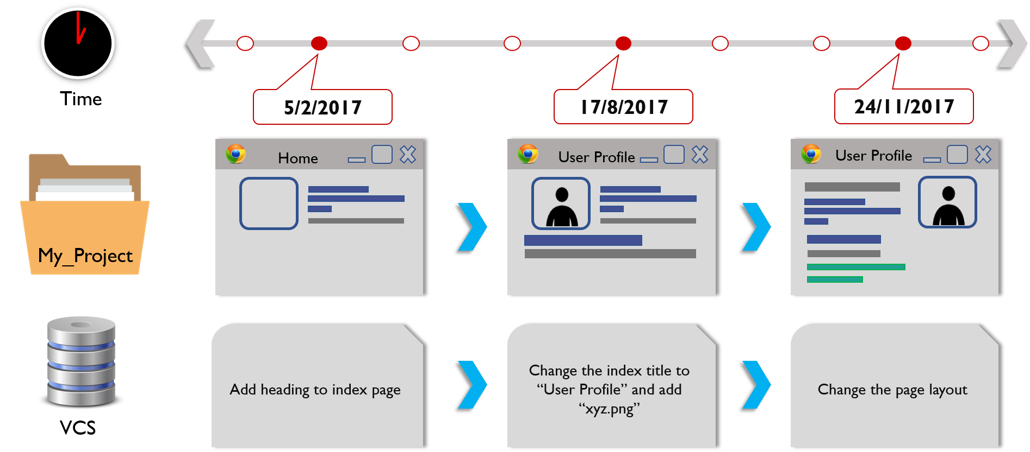

Slide 10
Version Control System(VCS)
A version control system or VCS, also know as revision control or source control system, is a software utility that tracks and manages changes to a filesystem.
A VCS also offers collaborative utilities to share and integrate these filesystem changes to other VCS users.
When operating at the filesystem level, a VCS will track the addition, deletion, and modification actions applied to files and directories.
Filesystem includes code, binary files, and digital assets.
In the scope of individual source code files, a VCS will track additions, deletions, modifications of the lines of text within that file.
VCS are sometimes known as SCM (Source Code Management) tools or RCS (Revision Control System)
Notes:
https://bitbucket.org/product/version-control-software

Slide 11
Benefits of VCS
Enhances the project development speed by providing efficient collaboration.
Leverages the productivity, expedite product delivery, and skills of the employees through better communication and assistance.
Reduce possibilities of errors and conflicts meanwhile project development through traceability to every small change.
Employees or contributor of the project can contribute from anywhere irrespective of the different geographical locations through this VCS.
Notes:
https://www.geeksforgeeks.org/version-control-systems/

Slide 12
Benefits of VCS
For each different contributor of the project a different working copy is maintained and not merged to the main file unless the working copy is validated.
Helps in recovery in case of any disaster or contingent situation
Informs us about Who, What, When, Why changes have been made.

Slide 13
Types of Version Control System
Local Version Control Systems
Centralized Version Control Systems
Distributed Version Control Systems
Notes:
https://git-scm.com/book/en/v2/Getting-Started-About-Version-Control
https://www.javatpoint.com/git-version-control-system
https://www.geeksforgeeks.org/version-control-systems/
https://medium.com/@shashankmohabia/up-and-running-with-version-control-systems-88c9857abe09

Slide 14
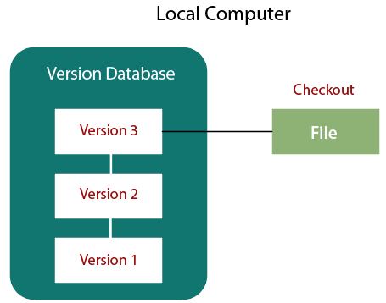
Local Version Control Systems

Slide 15
Local Version Control Systems
Many people’s version-control method of choice is to copy files into another directory (perhaps a time-stamped directory, if they’re clever).
This approach is very common because it is so simple, but it is also incredibly error prone. It is easy to forget which directory you’re in and accidentally write to the wrong file or copy over files you don’t mean to.
To deal with this issue, programmers long ago developed local VCSs that had a simple database that kept all the changes to files under revision control.

Slide 16
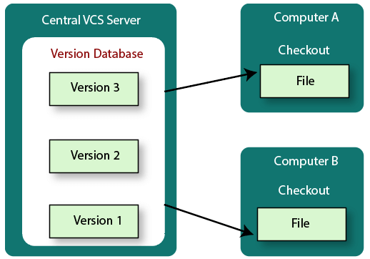
Centralized Version Control Systems

Slide 17
Centralized Version Control Systems
The next major issue that people encounter is that they need to collaborate with developers on other systems.
To deal with this problem, Centralized Version Control Systems (CVCSs) were developed.
These systems (such as CVS, Subversion, and Perforce) have a single server that contains all the versioned files, and a number of clients that check out files from that central place.
For many years, this has been the standard for version control.

Slide 18
Advantages of Centralized VCS
Everyone knows to a certain degree what everyone else on the project is doing.
Administrators have fine-grained control over who can do what, and it’s far easier to administer a CVCS than it is to deal with local databases on every client.

Slide 19
Disadvantages of Centralized VCS
The most obvious is the single point of failure that the centralized server represents.
If that server goes down for an hour, then during that hour nobody can collaborate at all or save versioned changes to anything they’re working on.
If the hard disk the central database is on becomes corrupted, and proper backups haven’t been kept, you lose absolutely everything — the entire history of the project except whatever single snapshots people happen to have on their local machines.
Local VCSs suffer from this same problem — whenever you have the entire history of the project in a single place, you risk losing everything.

Slide 20
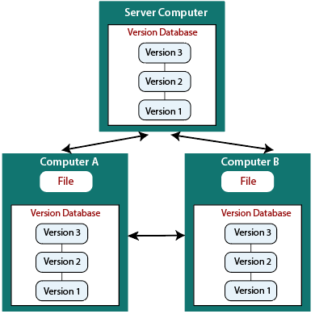
Distributed Version Control Systems

Slide 21
Distributed Version Control Systems
In a DVCS (such as Git, Mercurial, Bazaar or Darcs), clients don’t just check out the latest snapshot of the files; rather, they fully mirror the repository, including its full history.
Thus, if any server dies, and these systems were collaborating via that server, any of the client repositories can be copied back up to the server to restore it.
Every clone is really a full backup of all the data.
Furthermore, many of these systems deal pretty well with having several remote repositories they can work with, so you can collaborate with different groups of people in different ways simultaneously within the same project. This allows you to set up several types of workflows that aren’t possible in centralized systems, such as hierarchical models.

Slide 22
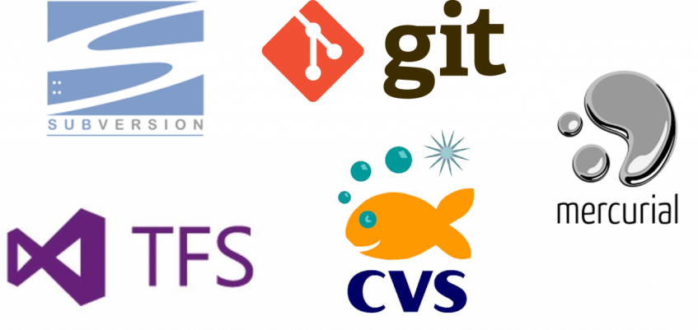
Version Control Systems

Slide 23
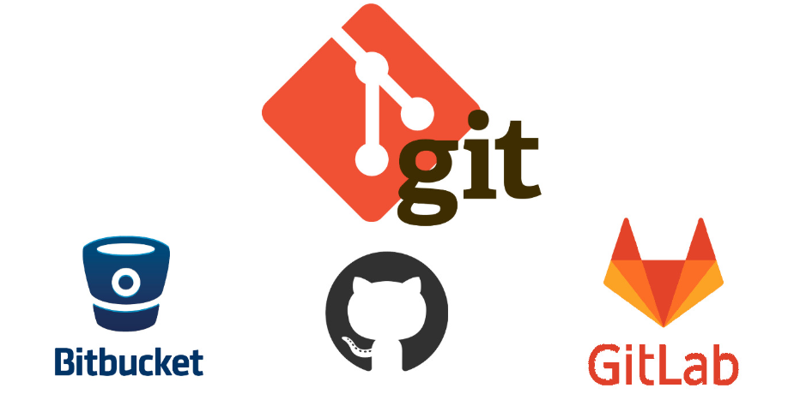

Slide 24
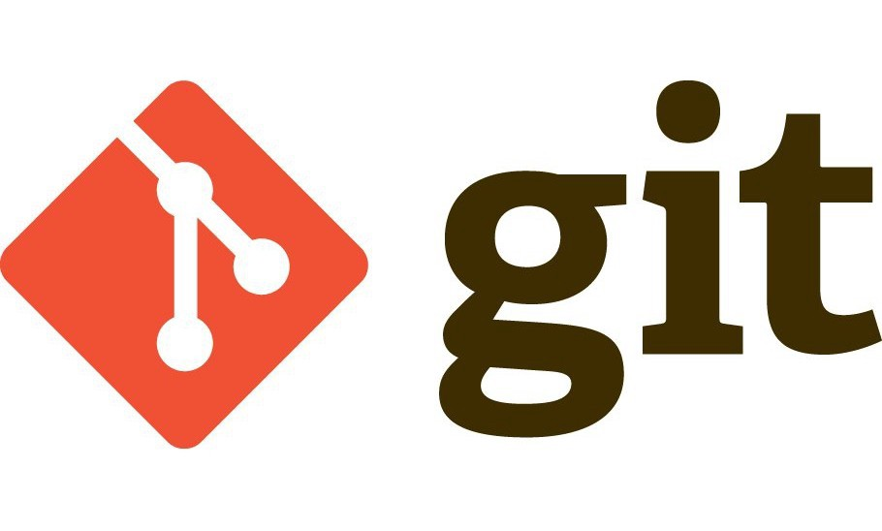

It is a software | It is a service
It is installed locally on the system | It is hosted on the Web
It is a command-line tool | It provides a graphical interface
It is a tool to manage different versions of edits made to files in a git repository | It is a space to upload a copy of your Git repository
It provides functionalities like Version Control System Source Code Management | It provides functionalities of Git like VCS and Source Code Management, as well as adding few of its own features
Notes:
https://dzone.com/articles/git-vs-github-demystifying-the-differences

Slide 25
To keep track of the code
To Synchronize the code

Slide 26
Sign up/ sign in – Github Repository
+ button in the right – new repository

Slide 27
Git clone
To work on the Git repository
Need Git in your system :
The command to check is:
git in the command prompt
Gitbash is to work on git commands in command prompt on Windows
Or Download :
https://www.stanleyulili.com/git/how-to-install-git-bash-on-windows

Slide 28
Git clone
Git clone <url> in the command prompt
to work on the repository
Add your documents into your local repository
git add file.py

Slide 29
git status
yet to be committed status of the file
git commit –m “msg”
msg – to understand the updates
committed in the local repository
git status
suggest u to commit the changes in github (repository)
git push
will add to the repository

Slide 30
git pull
to download the current file and work
git commit –am “message” → ?
Notes:
add and commit

Slide 31
Merge Conflicts
Sometimes both files do not match
Changed in local repository
And changed in git repository by others (downloaded file content is different)
git pull will show merge conflicts ( as local and repository changes are there)
To resolve this →

Slide 32
To resolve this
Use the correct code
Git commit –am “ changed the value to 30”
Git push

Slide 33
Git reset
Git reset – hard <commit hash>
Git reset –hard origin/master

Slide 34
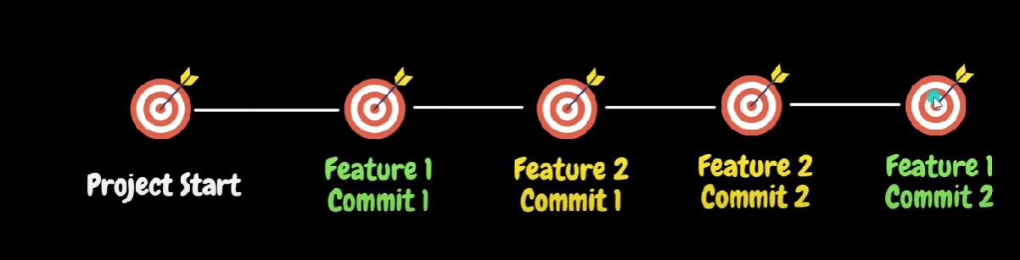
Git branch

Slide 35
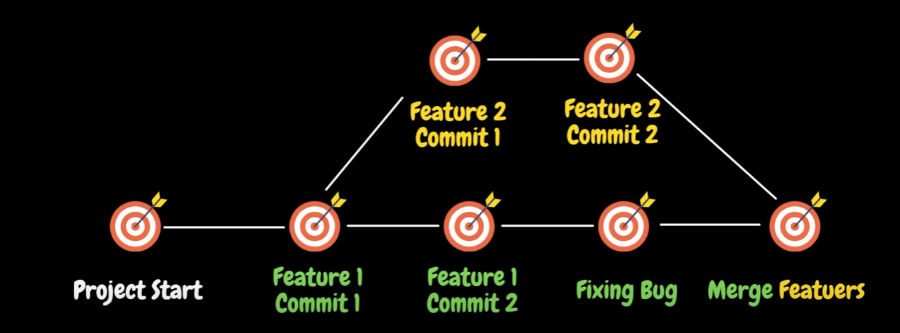

Slide 36
Git branch
shows the branches and which branch you are(*)
Switching between branches
Git checkout –b “branch1” (for new branch)
Git checkout “main” (for existing branch)

Slide 37
Merging between branches
Git merge branch1 (if u are in main branch)
Then git push

Slide 38
Key points from the demo
Create account in https://github.com/
Install Git Bash from https://git-scm.com/downloads
Basic Git commands
git --version
git help config/ git config --help
git config --global user.username (github userName)
git config --global –list
Notes:
https://www.stanleyulili.com/git/how-to-install-git-bash-on-windows/

Slide 39
Key points from the demo
Adding project from local
git init
git remote set-url origin (proj-url)
Fetching project from git
git clone (proj-url)
Git commands for pushing the code
git status
git add .
git commit
git push

Slide 40
Key points from the demo
Working in group
git stash
git pull
git stash pop
git status
git add .
git commit
git push

Slide 41
Try
Branching and merging
git branch (branch-name)
git checkout (branch-name)
git merge (branch-name)
Example:
git branch dev
git checkout dev
Make changes and commit to dev branch
git checkout master
git merge dev

Slide 42
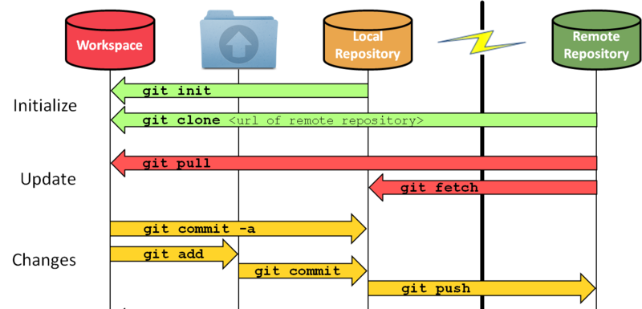

Slide 43
Do the following
Add a print statement to print your name in the python file shared in the repository

